Slide 1
UBER CASE STUDY PRESENTATION
Manjiri Paranjape

Slide 2
Table of Contents
Project Abstract (Business Objective)
Process Methodology
Data Overview (Inputs)
Data Preparation (Cleansing & Obtain Derived metrics)
Data Analysis (Univariate, Bivariate Analysis)
Confirm Problem statement & State Problem Hypothesis
Supporting Plots
Recommendations (Solution)

Slide 3
Project Abstract
Company Summary:
UBER is a mobile technology platform that connects driver partners to riders
UBER generates revenue by charging commission for each ride that is availed using this platform
Business Objective :
Identify root cause for driver cancellation and non-availability of cars for airport rides leading to potential revenue loss for UBER
Recommend potential solutions for the problem
Demarcations :
The data has been provided for only 5 consecutive weekdays of July 2016 and contains only rides to & fro the airport
Tools used
R
Tableau
Excel

Slide 4

Project Methodology
Exploratory
Data
Analysis
UBER Datahouse Data
Data is proceessed
Clean dataset
Plot graphs and models
Make decisions
Communication Visualize report

Slide 5
Data Analysis
Data Source : Real data source from UBER data warehousing solution
Data Understanding : The given data set has single csv with the following details
Driver id – unique to each partner driver
Request id - unique identification for each generated rider request for UBER
Pick up position – this is either City or Airport, the place where the ride request was initiated
Status – Status of each trip – whether Trip Completed (Successful) OR Cancelled / No cars available (Unsuccessful)
Request.timestamp and Drop.timestamp for the individual ride.
Data Limitations:
No customer id shared to verify if same customer had multiple requests in case of cancellations (to account for possible Revenue Loss)
No airport schedule available to recommend the possible queue up of taxis at airport at various times of the day
Only airport-city rides included in sample data that limits analysis of driver behavioral pattern for cancellations & no cars available

Slide 6
Data Analysis
Data Preparation
This mainly consisted of Data cleaning in this case study
All the Request and Drop timestamp cleaned and converted to POSIXCT format for easy manipulation by R libraries and numeric operations
Generate derived columns from Request and Drop timestamp for date, time, hour for ease of reporting
Data Modelling :
Data obtained from cleaning is ready for modelling. Data is churned to get more meaningful insights from the data
Create new columns like travel time (for ride), idle time (at airport) for analysis
Generate summary of inflow and outflow of cabs at airport by hour to study the commute trend
Data Evaluation:
There is an extensive data evaluation done for purpose of modelling.

Slide 7
Data Analysis continued..
Analysis Type | Finding | Results / Possible Hypothesis
Univariate analysis – Driver id | 6745 unique partner riders | Rider trends / preferences can be analyzed with this data
Univariate analysis – Pickup point | Morning (5-9 pm) : Almost 75% of incoming requests need ride from city to airport Evening (5-9 pm) : Almost 70% of incoming requests need ride from airport to city | The flight schedule for departing and arriving flights seem to influence the request pattern for cab to / fro the airport
Univariate analysis – Status | Morning (5-9 am) : Average 164 cancellations per day to airport which is 40% of incoming requests Evening (5-9 pm) : No cars available for average 264 rides to city which is 57% of incoming requests | Probably more flights departing but less flights arriving at the airport at this time. The possible idle time at airport makes airport ride non lucrative for drivers. Similarly, low number of departing flights from airport create no cars available in the vicinity scenario for the evening passengers coming from arriving flights
Request & drop timestamp | July 11-15, 2016 – essentially 5 days data . A slight increase in demand is observed on Monday mornings and Friday evenings otherwise the data is very comparable by day | The demand VS supply is driven by the time of day which will be basis for most of the analysis

Slide 8
Data Analysis cont
Analysis Type | Finding | Results / Possible Hypothesis
UBER Demand To / From Airport at various times of day | There is an imbalance in the demand of taxis towards city and towards airport in the peak morning and evening hours | This causes issue in the overall availability of taxis , especially in the evening when there are no cars available for ride from airport
Travel time VS idle time at airport | The report shows avg ride to airport from city to be around 52 min. The wait times vary widely from few min to few hours | The long ride to airport plus lesser probability of getting ride from airport probably causes drivers to cancel airport rides in the morning.
Driver wise trend for cancellations | The plot clearly shows – drivers initiating upto 9 cancellations weekly for rides to airport in the morning slot of 5-9 peak hours Mean =3 cancellation, 75 % of drivers have upto 4 cancellations | The upper edge of more than 4 cancellations/week would be the possible segment to target for possible penalties.
Incoming VS outgoing taxis at airport by hour | The comparison of inflow VS outflow shows
% Success trips by hour | The box plot shows the success % to be around 42% with IQR as 29% - 65%. | The cab cancellations and no cars available are clearly causing Revenue Loss to UBER and should be tackled to increase company profitability and reliability in the marketplace

Slide 9
Define Problem Statement
PROBLEM STATEMENT
UBER has only about 42% of success rate in handling total incoming requests causing potential loss of revenue
MOST PROBLEMATIC REQUESTS
Cancellations at Morning 5-9 am for incoming requests to airport ride amount to 39% of total morning incoming requests
No cars available at evening hours 5-9 pm for requests from airport amount to 56.4% of total evening incoming requests
There is inflow VS outflow imbalance of cabs at the airport causing queuing of cabs in the morning and no cars available in the evening.
HYPOTHESIS FOR DEMAND SUPPLY GAP
Morning time - More flights depart but less flights arrive at the airport. The average airport ride is 52 minutes and longer idle time at airport to get return ride back makes airport ride non lucrative for drivers.
Evening time – Mostly arriving flights at the airport at this time. In the evening, since there are no departing flights, there is very less inflow of cabs causing no cars available in the vicinity (no cars available scenario) for the evening passengers coming from arriving flights

Slide 10
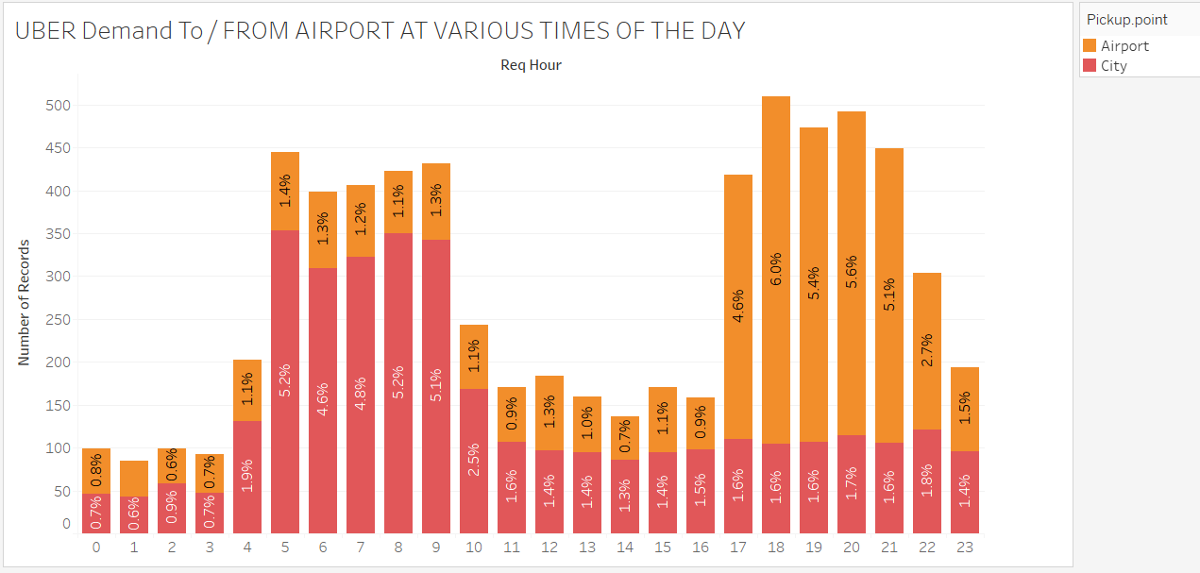
*Morning 5-9 hrs ride to airport & evening 5-9 hrs ride from airport contribute around 50% of total ride requests

Slide 11
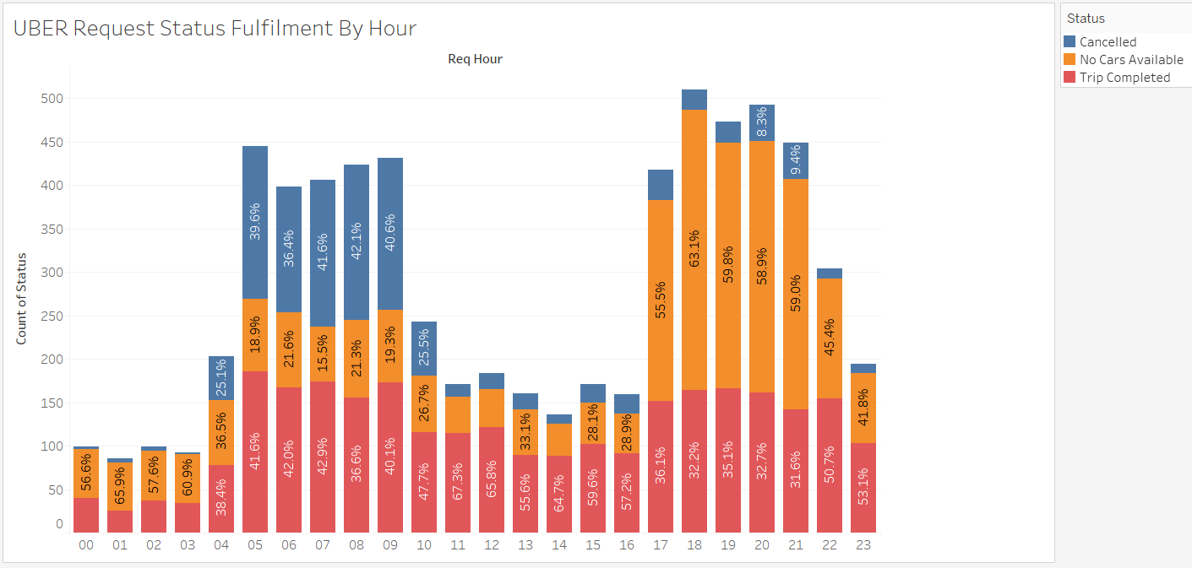
The highest gap in Demand VS Supply (Morning 5-9 hrs : Cabs Cancelled) and Evening (5-9 hrs : No Cars Available)

Slide 12
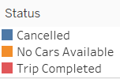
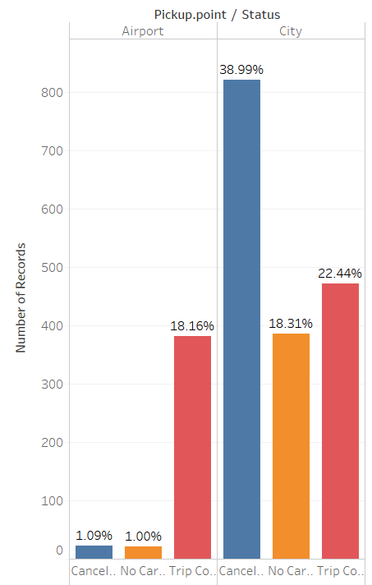
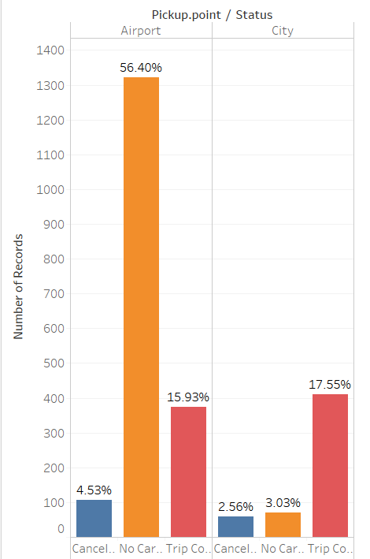
PROBLEM / LOW EFFICIENCY SCENARIOS
MORNING 5-9 hrs of request time
EVENING 5-9 hrs of request time
Cancellations to airport = 39% of morning requests
No cars available from airport = 56% of evening requests

Slide 13
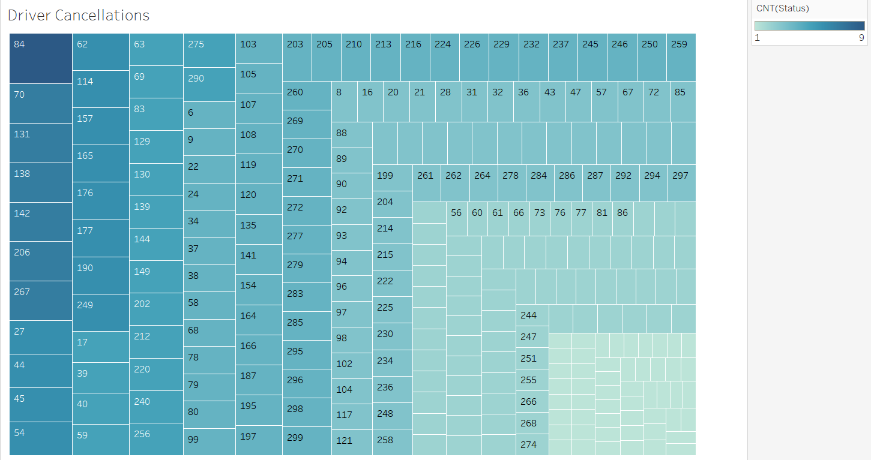
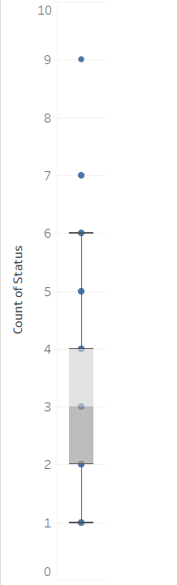
Morning cancellations for airport
Cancellations range from 1-9 per week for each driver.
75% percentile =4 cancellations. Data tallied with R code calculations
Cancellations of 5 or more may be candidates chosen for penalty

Slide 14
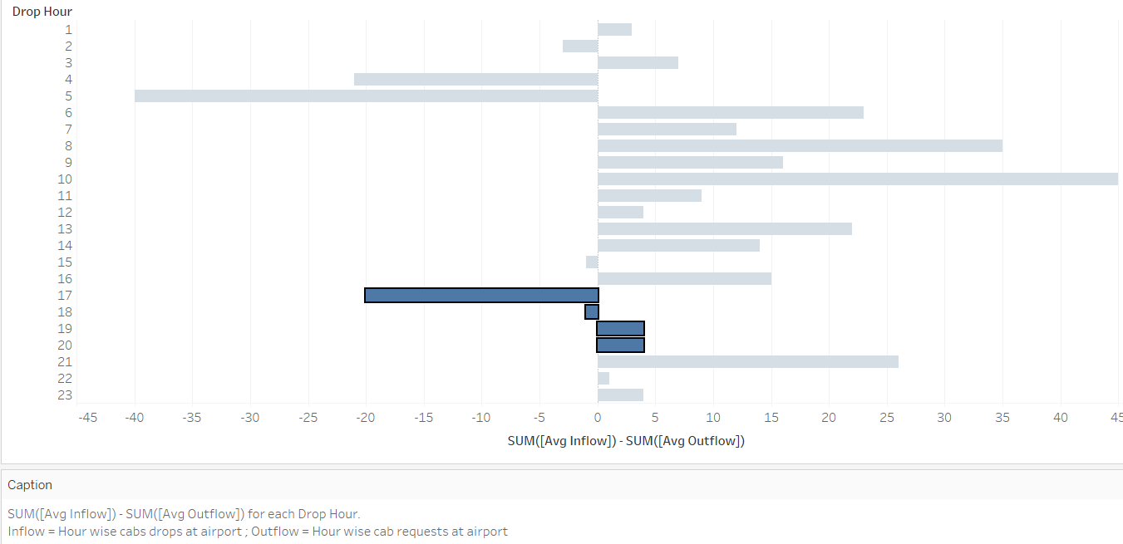
** The morning & afternoon idle cabs head out at 17 hours, after that there is deep shortage of cabs at the airport. It starts picking up at 21 hours (Avg inflow and outflow calculations in R code)

Slide 15
Recommendations
1. Incentives for airport rides to partner drivers in the morning peak hours
The idle times are at airport are great setback for morning rides to airport. Incentives to drivers to earn more from morning peak time airport rides may help offset loss of business in idle time
2. Penalty for n peak time airport ride cancellations – day wise / week wise
The cancellation ratio for morning peak hours have wide range from 1 to 13. Allowing a tolerance of 75%, top 25 percentile may be charged a penalty to resist airport rides at peak hours
3. Encourage drivers to schedule shift timings so that the evening shift does not end in the peak evening hours when no cabs are available for riders
Review driver shift times & their overlap with the morning or evening peak hours that might be causing drivers preference to handle only certain types of rides
4. Promote pool plan to pre-book and ride share for single riders to/fro airport with driver partners having bigger cars
UBER pool is a win-win where pre-planning the ride will give more reliable service to riders and possibly handle monetary offset to drivers because of multiple riders.
5. Look at flight landing / take off patterns at airport or historic data to predict the amount of cabs needed for morning & evening hours and alert waiting drivers for rider requests
Historic data can be used when possible to alert idle drivers to plan logistics of cab placements and availability at various pick up points.

Slide 16
THANK YOU

